Slide 1






From 2Q25 to Q3
MES, ESR and Video Surveillance solutions

Slide 2

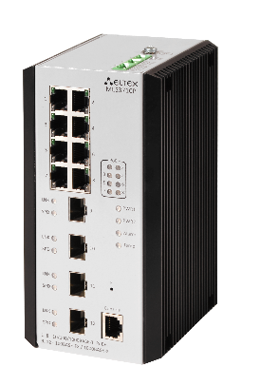
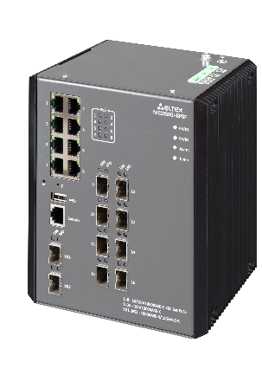
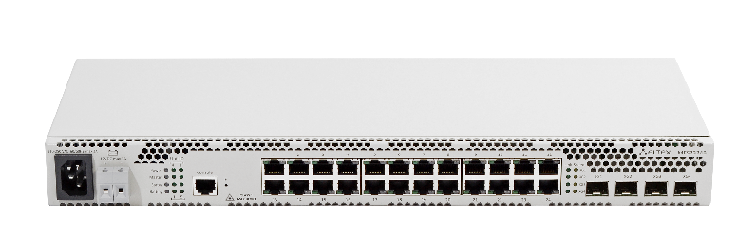
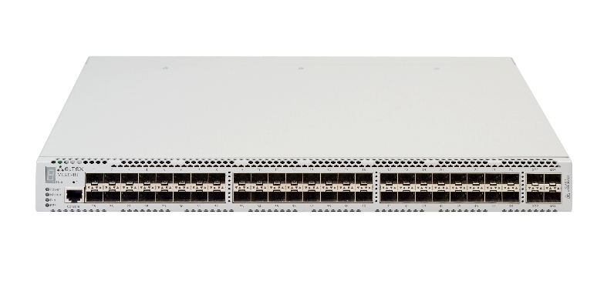
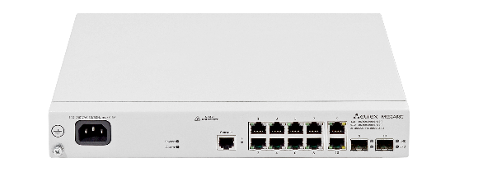
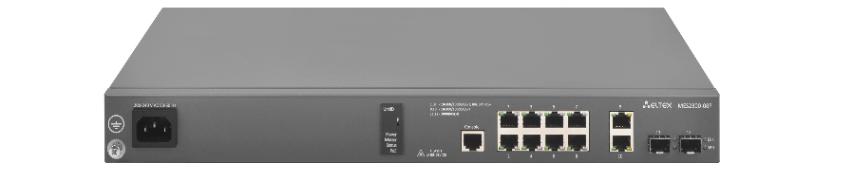

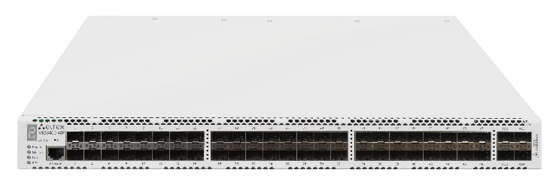
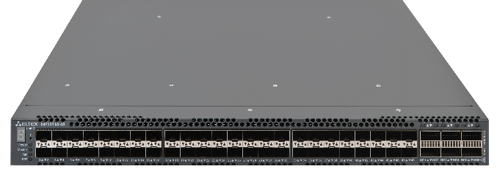
MES Equipment
Managed Ethernet Switches
ISS OS
MES24xx
MES3400
MES37xx
ROS4 OS
MES23xx
MES33xx
MES35xx
ROS6 OS
MES2300-xx
MES3300-xx
MES5400-xx
MES5500-xx onwards
ISS - например, MES2408C, MES3400-48 и MES3710P
ROS4 - MES2324B, MES3348F
ROS6 - MES2300-08P, MES5300-48, MES3500I-8P8F (чтобы с графитовыми корпусами)

Slide 3


ISS OS – Goals for Q2
24xx, 3400, 37xx
Stacking improvements
OSPF
Dot1x
RPVST
Serial number output for all units via CLI
Aggregation of stack ports into a stack LAG
Binding table synchronization

Slide 4

ISS OS – Goals for Q3
24xx, 3400, 37xx
Further stacking improvements
Dying Gasp
VLAN translation
Port ingress/egress rate limit
EOAM (EEE 802.3ah)
Release 10.4.3 Stable includes all the scheduled updates and is available for early adopters by 30.09.2025

Slide 5

ROS4 OS – General roadmap
23xx, 33xx, 35xx, 5324
2025
2026
2027
2028 onwards
1 release (4.0.26)
2 major releases
1 major release
Patches only
Release goals
Bugfixes
Minor updates

Slide 6


ROS6 OS – Goals for Q2
2300, 3300, 5332A, 5400, 5500, 56-57
NSF L2 (all stackable models) implementation started at the beginning of 2025 with the stabilization phase in Q2
NSF L2 functionality is available for testing in v6.6.8.8

Slide 7
ROS6 OS – Goals for Q2
2300, 3300, 5332A, 5400, 5500, 56-57
Development of Data Center functionality
PFC (Priority-based Flow Control) – development is completed, currently in stabilization phase
Bringup of the “S” series of industrial switches
MES3510S-08P
MES3510DS-24F

Slide 8

ROS6 OS – Goals for Q2
2300, 3300, 5332A, 5400, 5500, 56-57
Functionality porting from ROS4
18 tasks, including
Stacking support for MES2300-24P and MES2300-48P (following ROS4’s MES2324P and MES2348P)
Loopback Detection per VLAN
IP Source Guard per VLAN

Slide 9
ROS6 OS – Goals for Q3
2300, 3300, 5332A, 5400, 5500, 56-57
Version ROS 6.6.9 Release is available by 08.09.2025
MPLS L3VPN stabilization
in a feature branch and release in version 6.6.10
NSF L2 release at the end of Q3 in ROS 6.6.9
Start of NSF L3 implementation,
aiming for 1Q26
Data Center functionality:
PFC is available in version 6.6.9
HSR/PRP redundancy protocols
Start of implementation in July aiming for release by 30.09.2025
Functionality porting from ROS4.
13 tasks, including
Use of Spanning-tree Guard Loop
Route-map for route redistribution
Password change via TACACS+

Slide 10


MES Hardware – Goals for Q3
ROS6
ISS
MES3500I-24F, MES3510S-08P,
MES2310-48DP – testing
MES3500I-8P8F – pre-production testing completed (16 units available), ordering the first batch
MES5320-24, MES5700-32 – bringup
is completed
MES2420D-24DP
pre-production is completed
and available for partners for testing, first batch is ordered

Slide 11

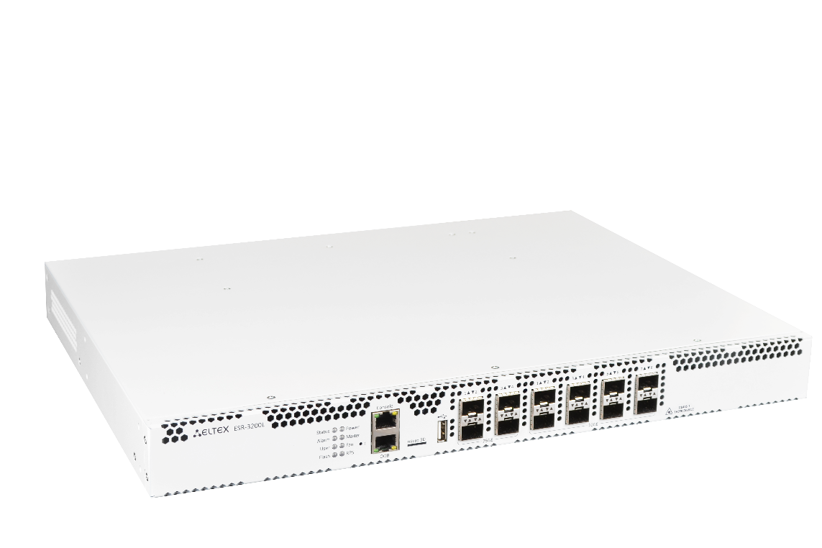
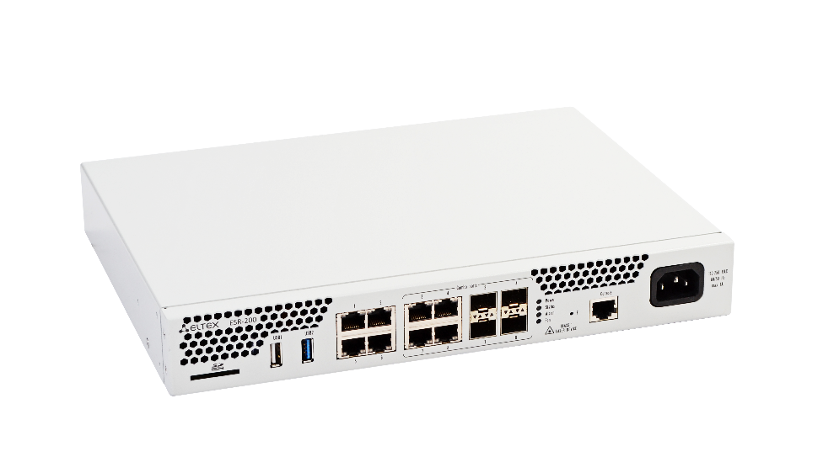

ESR Equipment
Ethernet Service Routers

Slide 12
ESR Q2-Q3 (clustering)
v1.37.0 (30.09.2025)
Active/Standby 1+N
Configuration synchronization for 3-unit cluster architecture based on VRRP (Active/Standby 1+2) → version 1.37.0
Active/Standby 2+1
VRRP-based Active/Active cluster architecture with more than 2 ESR units → version 1.40.0

Slide 13
ESR Q2-Q3 (security)
v1.37.0 (30.09.2025) / v1.40.0 (26.12.2025)
NGFW
Firewall
IPsec
Firewall rules application by schedule → version 1.40.0
Configuration service re-design, integration with CA → version 1.37.0
DMVPN (in-house solution)
GeoIP
Automatic tunnel establishing between multiple hosts → solution architecture design stage
Traffic filtering by geolocation functionality → version 1.40.0
Fail2ban
Server log analysis and restriction of suspicious IP-addresses → version 1.40.0

Slide 14


ESR Q2-Q3
v1.40.0 (26.12.2025)
NGFW
HTTPs Proxy
Integration of the solution into ESR → version 1.40.0
Certificates
Key pair import/export, source interface specification → version 1.40.0
DMVPN
Development of an in-house solution continues → version 1.40.0

Slide 15

ESR Q2-Q3 (routing)
1.40.0 Stable (30.09.2025)
PIM SM (Multicast development)
Support for Protocol Independent Multicast Sparse Mode → version 1.40.0
IGMP
Support for IGMPv3 protocol → version 1.40.0

Slide 16

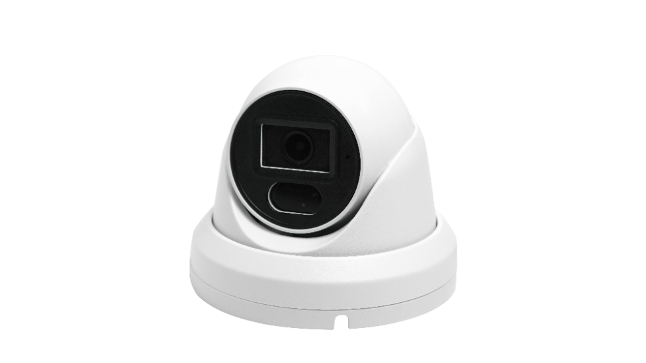
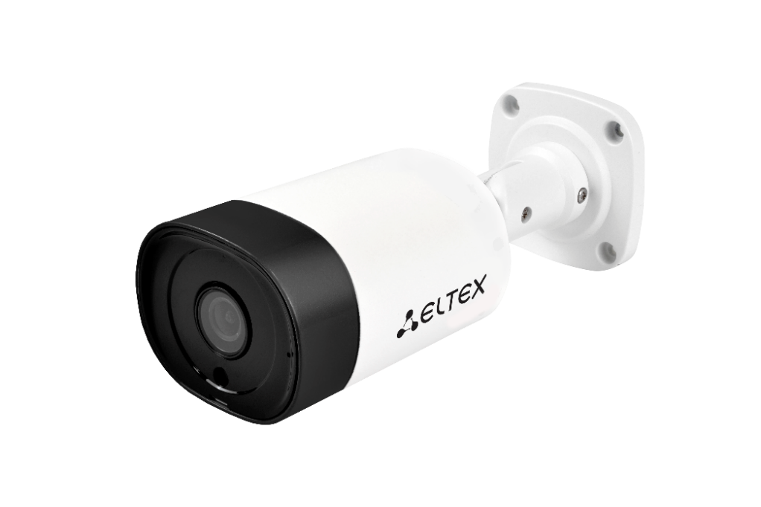
Video Surveillance
IP-cameras and EVI Platform

Slide 17


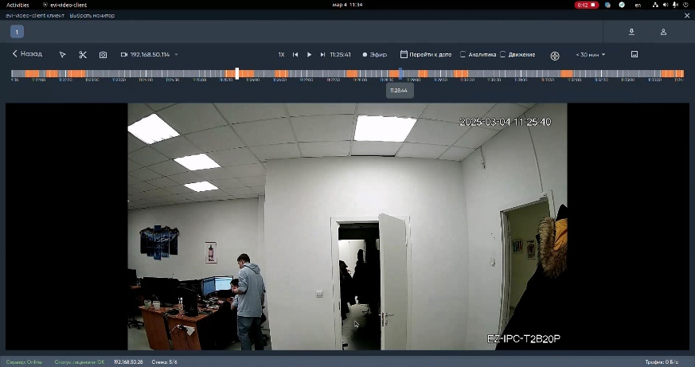
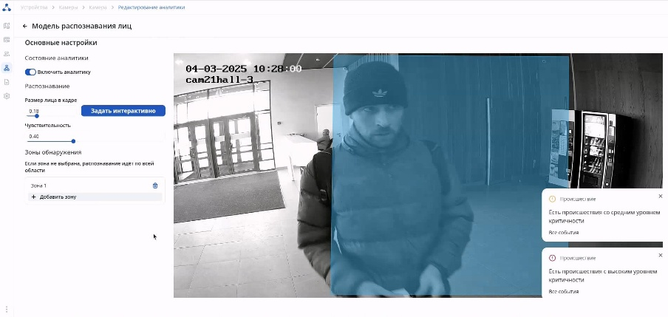



EVI Platform 1.4.0 Release
Scheduled for 31.08.2025
Front-end
У
У
EVI Web (Chrome)
EVI Video Client (Winows/Linux)
Re-designed interface structure
Support for h.265 video codec in Chrome
Support for English language
Back-end
EVI Perimeter
EVI SCUD
EVI Analytics
Optimized interaction with the archive
Centralized firmware upgrade
for controllers
Flexible schedule and role-based access policy for checkpoints
Support for square number plates
Support for CIS countries number plates
Armenia, Azerbaijan, Belarus, Kazakhstan, Kyrgyzstan, Moldova, Russia, Tajikistan, Turkmenistan, Uzbekistan

Slide 18

EVI Platform Development
ONVIF
Analytic modules
Analytics RnD
Remote advanced setting adjustment
Parking lot
(number of taken and available parking spots)
Personal protective equipment (helmets, masks, vests, uniform)
Emergency vehicles
(ambulance, police, fire trucks, military vehicles)
Support for international
number plate types
Support for number plate lists (non-PACS)
Person search
(by specified parameters:
face, height, clothes)
Number plate search
in the archive
Search by color
(clothes, body parts)
Search in the archive
(text queries)
PTZ control menu improvement
Zoom control
Focus
Sharpness
IR highlight
Support for wipers
Support for presets
Mobile App
Client application development
for iOS and Android

Slide 19
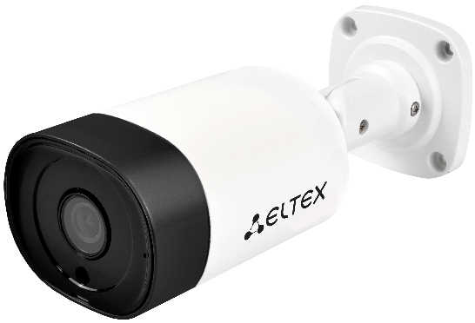
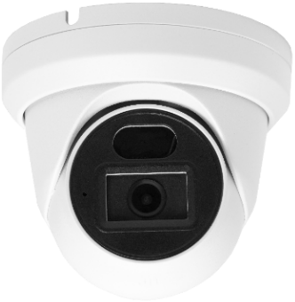
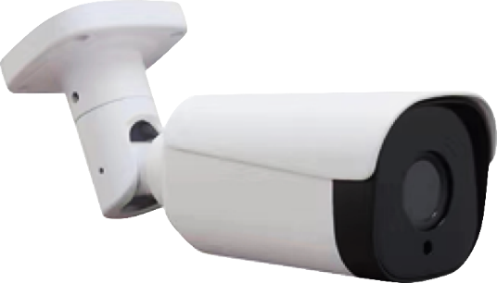
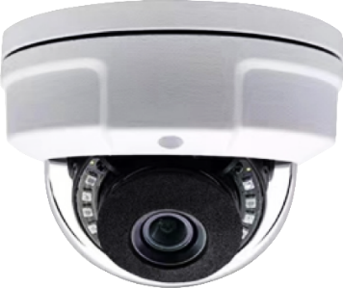
IP Cameras – Goals for Q3
SV-BA Series
SV-BB Series
SV-BA301
SV-BA314
SV-BB341Z
SV-BA331
Software (v1.7.0)
Software (v1.0.0)
Support for additional audio codecs
(ADPCM, G.711U (PCMU), G.711A (PCMA), G.726)
Smart Infrared
Two-way audio communication (for Q4)
Bringup, True WDR functionality testing
Software development for SV-BB331
Hardware
Hardware
SV-BA331 tamper-proof dome: first units
are available for testing
Revision B: integration of 4M 1/2.7”
image sensor, support for PoE Mode B
SV-BB341Z varifocal: first testing batch is released

Slide 20





We are always open to discuss, develop
and customize products to your needs
29V, Okruzhnaya St., Novosibirsk, Russia, 630020
09:00 — 18:00 (GMT+7)
Monday - Friday
+7 (383) 274-10-01, 274-48-48
eltex@eltex-co.com; eltex-co.com
Eltex Enterprise Ltd. | Russian developer and manufacturer of telecommunication equipment

